Slide 1
Sources of Energy
CHAPTER 14
Part 4- Environmental Consequences
Notes:
Lets start with our Chapter 1- that is Chemical Reactions and Equations

Slide 2
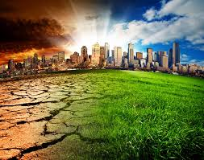
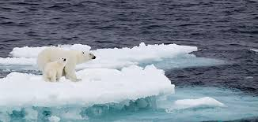
Environmental Consequences
Exploiting any source of energy disturbs the environment in some way or the other.
The correlation between climate and energy rests on known causal relationships between human population growth, rising energy consumption and land use and the resulting greenhouse gas emissions and climate change.
Notes:
Exploiting any source of energy disturbs the environment in some way or the other. In any given situation, the source we would choose depends on factors such as the ease of extracting energy from that source, the economics of extracting energy from the source, the efficiency of the technology available and the environmental damage that will be caused by using that source.

Slide 3

How does the use of energy affect the climate
Temperature, Energy Demand, and Energy Supply
Notes:
Increases in temperature will likely increase our energy demand, as well as change our ability to produce electricity and deliver it reliably. In a warmer climate, Americans will use more electricity for air conditioning and less natural gas, oil, and wood for heating.

